Slide 1

Introduce UI event handling and User Input

Slide 2
Learning Objectives
Introduction to UI Events Handling and Touch Input
Learn how to handle UI events for responsive interfaces.
Gain hands-on experience in implementing touch input functionality.

Slide 3
UI Events Handling
The Event System is a way of sending events to objects in the application based on input, be it keyboard, mouse, touch, or custom input. The Event System consists of a few components that work together to send events.
The primary roles of the Event System are as follows:
Manage which GameObject is considered selected
Manage which Input Module is in use
Manage Raycasting (if required)
Updating all Input Modules as required
Canvas uses the EventSystem object to help the Messaging System.

Slide 4
UI Events Handling
Input Modules
An Input Module is where the main logic of how you want the Event System to behave lives, they are used for:
Handling Input
Managing event state
Sending events to scene objects.
Only one Input Module can be active in the Event System at a time, and they must be components on the same GameObject as the Event System component.

Slide 5
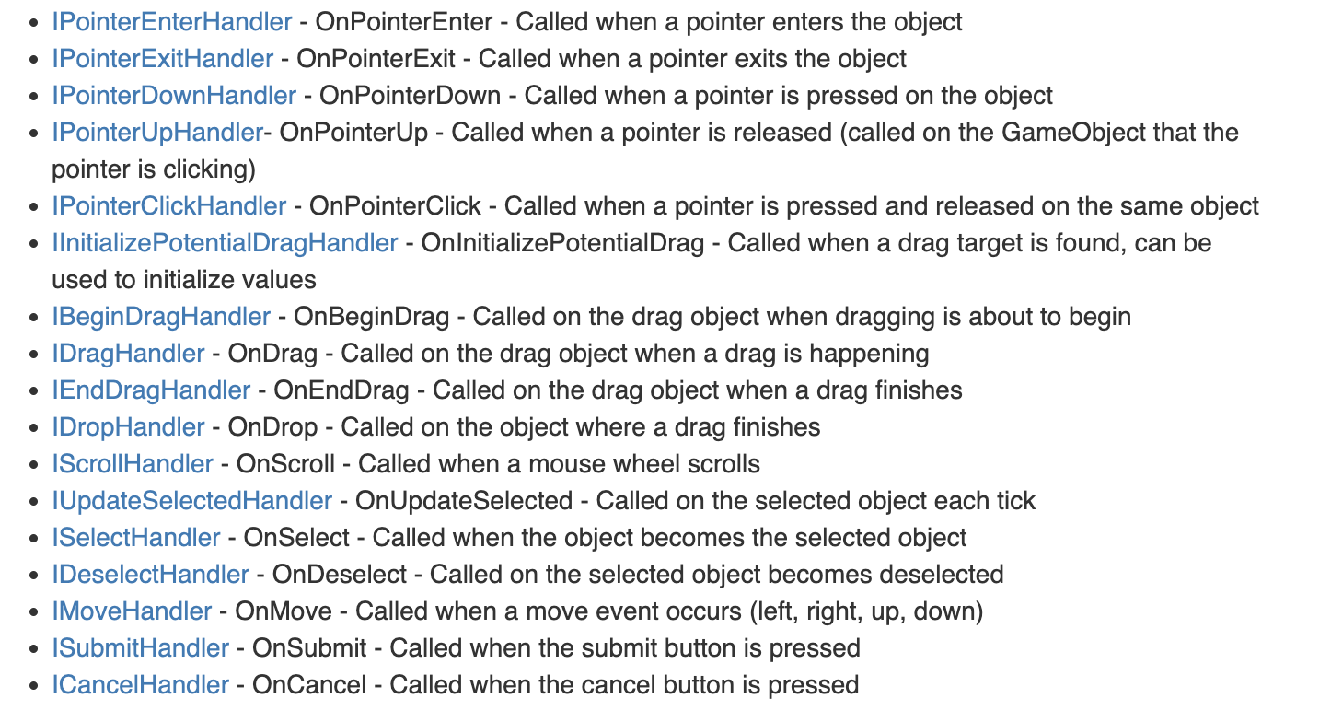
UI Events Handling
Supported Events
The Event System supports a number of events, and they can be customized further in user custom user written Input Modules.
The events that are supported by the Standalone Input Module and Touch Input Module are provided by interface and can be implemented on a MonoBehaviour by implementing the interface.

Slide 6
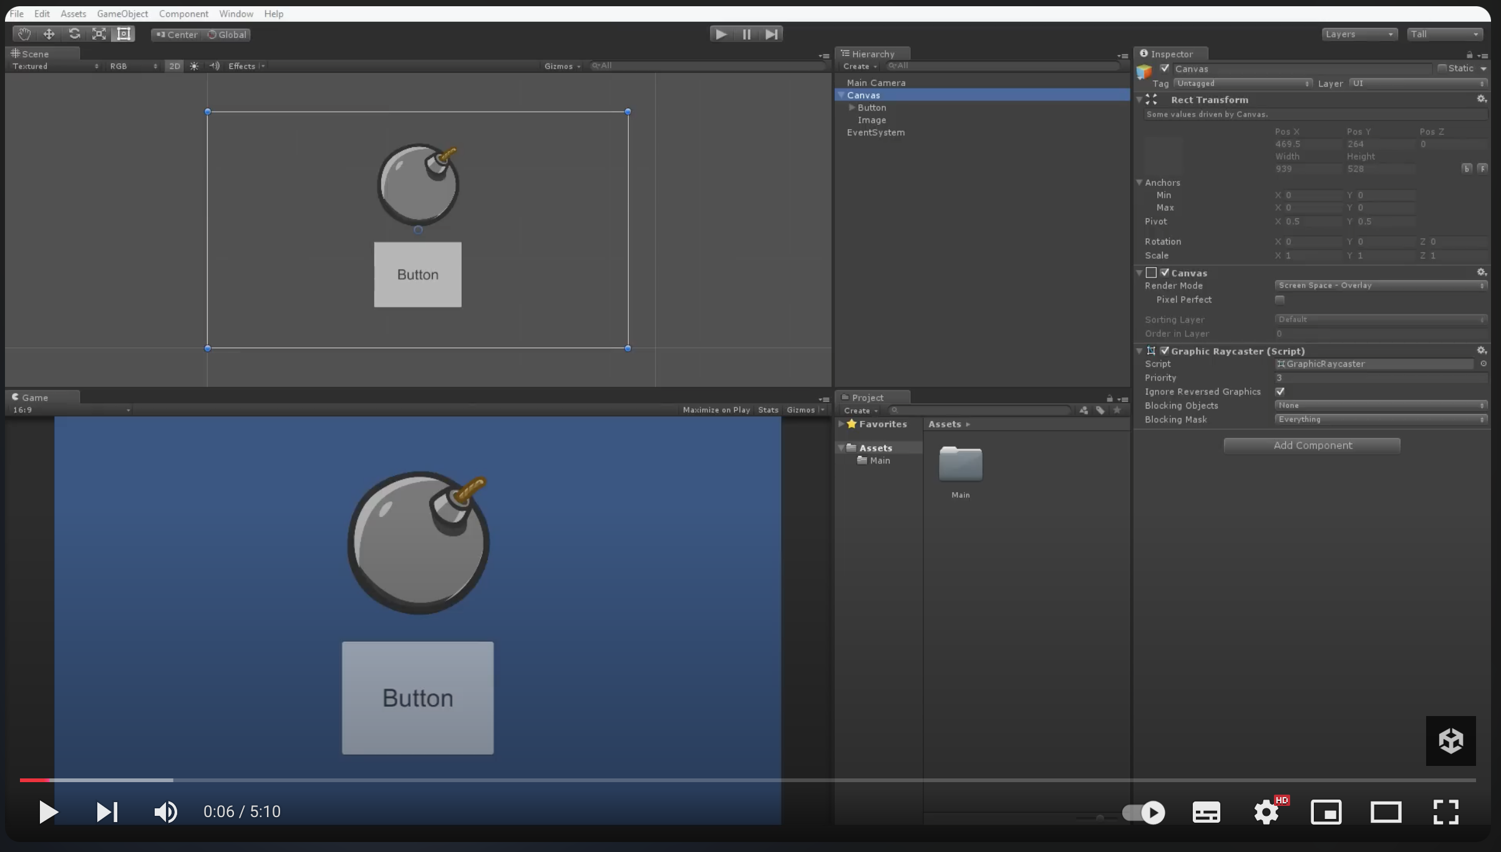
UI Events Handling
UI Events and Event Triggers - Unity Official Tutorials
References: https://www.youtube.com/watch?v=3NBYqPAA5Es

Slide 7
Touch Input Basics
Touch input in Unity refers to the ability to handle interactions on touch-enabled devices, such as smartphones and tablets. Unity provides several methods and modules to facilitate touch input in your games or applications.

Slide 8
Touch Input Basics
Unity offers several methods to handle touch input:
Unity Input System: A modern and flexible system that supports various input types, including touch.
Legacy Input Manager: The Input.GetTouch method can be used to retrieve touch information.
Event System: Handles touch events for UI elements.
Mobile Input Module: Specifically designed for touch interactions in UI.
Third-Party Libraries: Libraries like TouchScript provide advanced touch handling features.

Slide 9
Mobile UI Best Practices
Implementing an on-screen joystick with Input System:
To implement this on-screen joystick, we will utilize two images: a background image and then a joystick image placed on top of it. We will then write code to allow the player to simulate that they are physically moving the joystick.

Slide 10
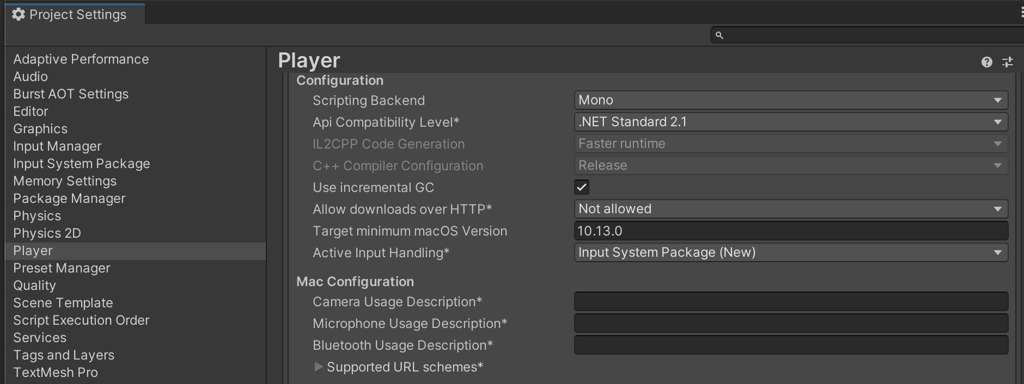
Mobile UI Best Practices
Implementing an on-screen joystick with Input System
Import Input System package.
And set Player “Active Input Handling” config to “Input System Package (new)”.

Slide 11
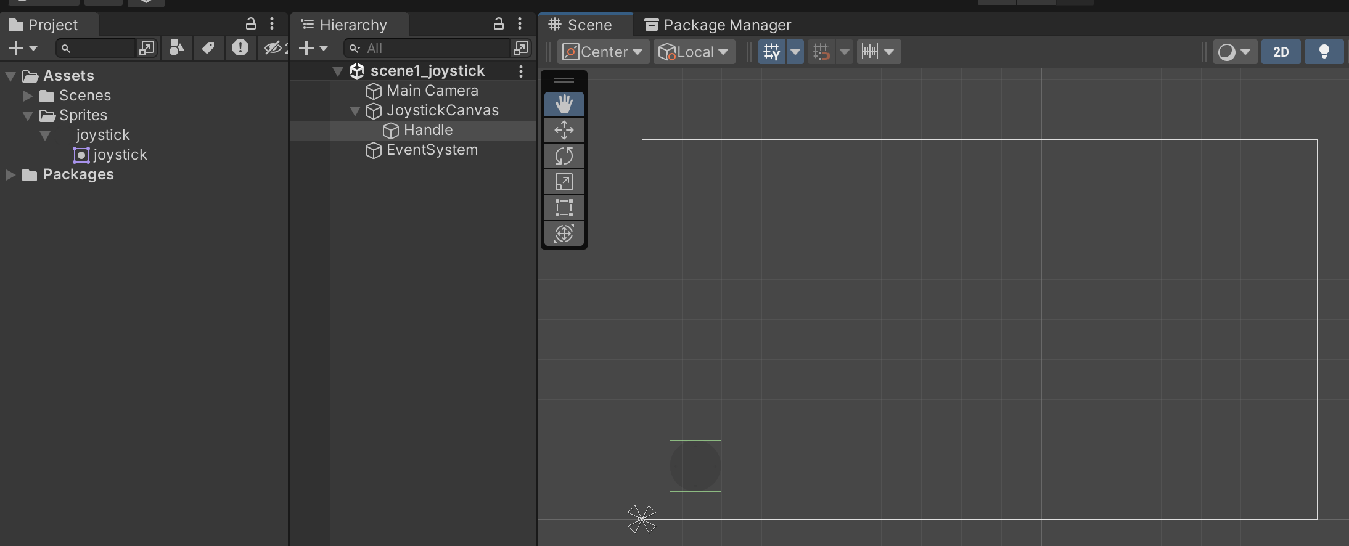
Mobile UI Best Practices
Implementing an on-screen joystick with Input System:
Create the UI for joystick
Add a canvas.
In canvas, and an UI > Image game Object and set joystick image for this object. Set name is ‘Handle’

Slide 12
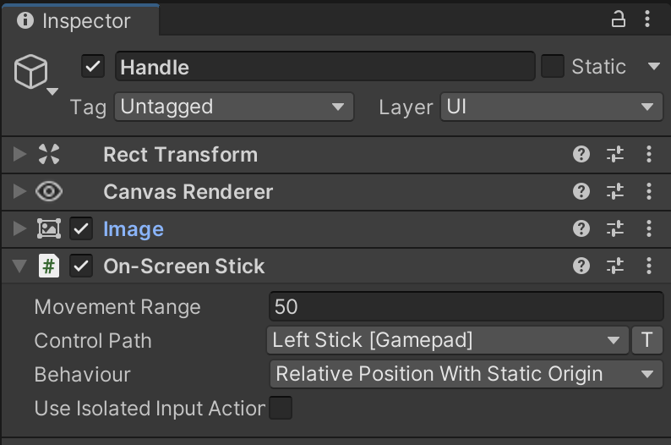
Mobile UI Best Practices
Implementing an on-screen joystick with Input System:
Add On-Screen Stick component
Select Handle GameObject, click add component and select “On-Screen Stick”.
Set param: Movement Range = 50; Path = LeftStick [Gamepad].

Slide 13
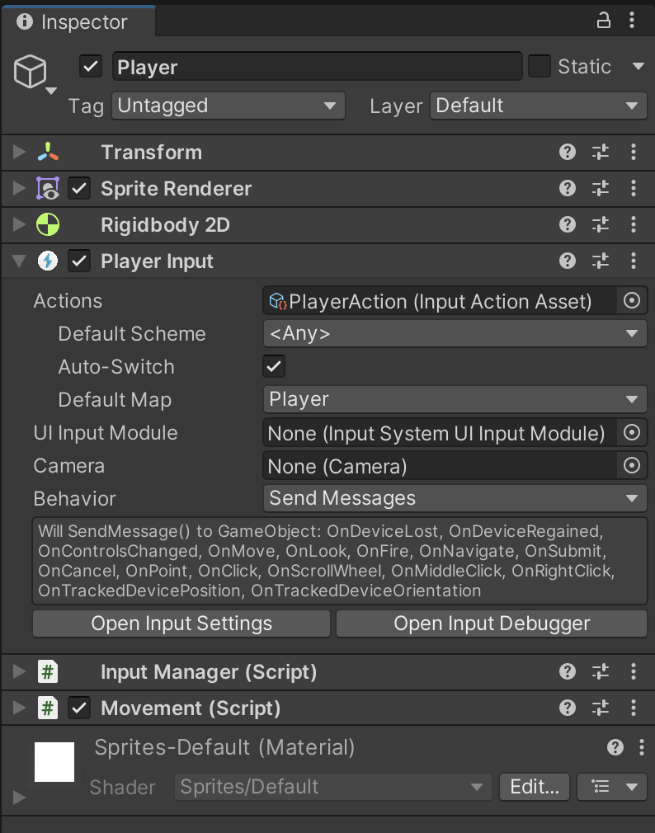
Mobile UI Best Practices
Implementing an on-screen joystick with Input System:
Add Player and its component
Add 2D Object > Sprites > Triangle GameObject. Set its name to Player.
Add Rigidbody 2D component to Player.
Select Player, add “Player Input” component (NOT player input manager).

Slide 14
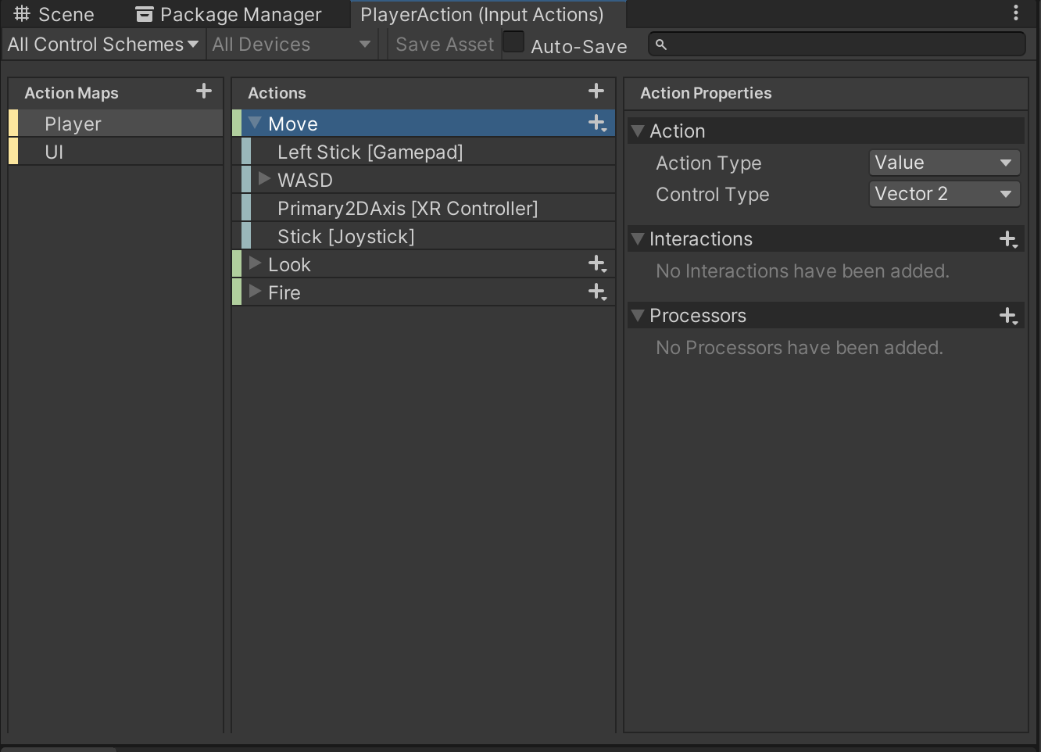
Mobile UI Best Practices
Implementing an on-screen joystick with Input System:
Add Input Actions for Player Input component
Select Player, in Player Input component, click Create Actions. Set name is PlayerAction and save to Scenes / InputSystem folder.
Double click on PlayerAction Object to open Input Actions window. Set value for Move action.
Action Type: Value
Control Type: Vector 2

Slide 15
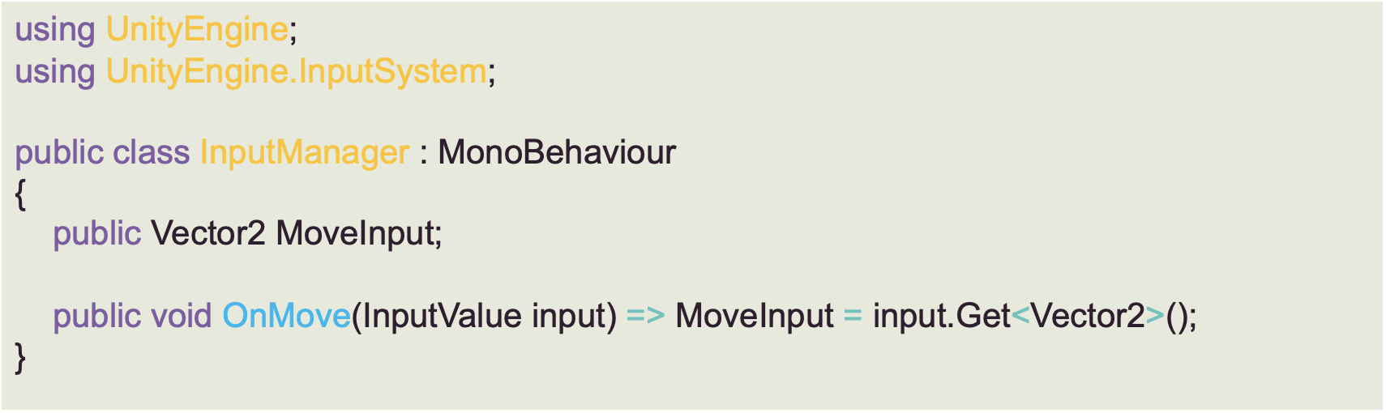
Mobile UI Best Practices
Implementing an on-screen joystick with Input System:
Add the InputManager.cs and Movement.cs C# scripts and attach them to Player.
Add 2D Object > Sprites > Triangle GameObject. Set its name to Player.
Select Player, add “Player Input” component (NOT player input manager).

Slide 16
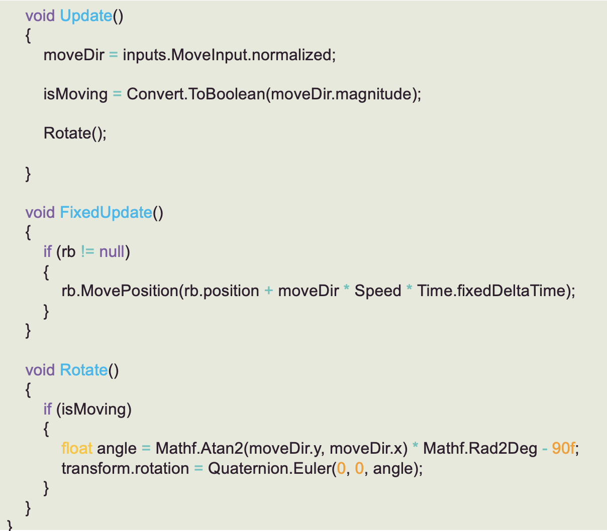
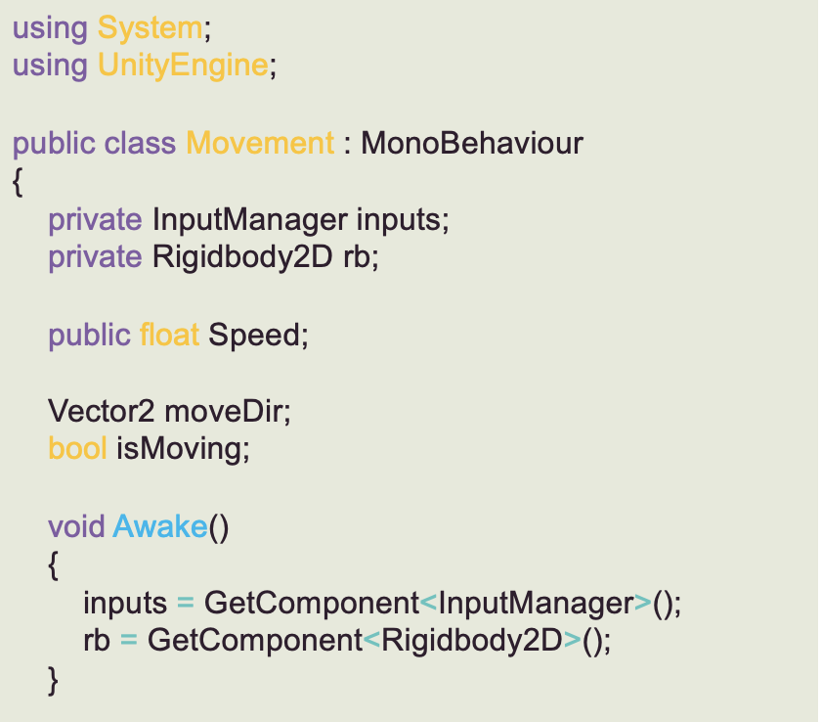
Mobile UI Best Practices
Update Movement.cs script

